Slide 1
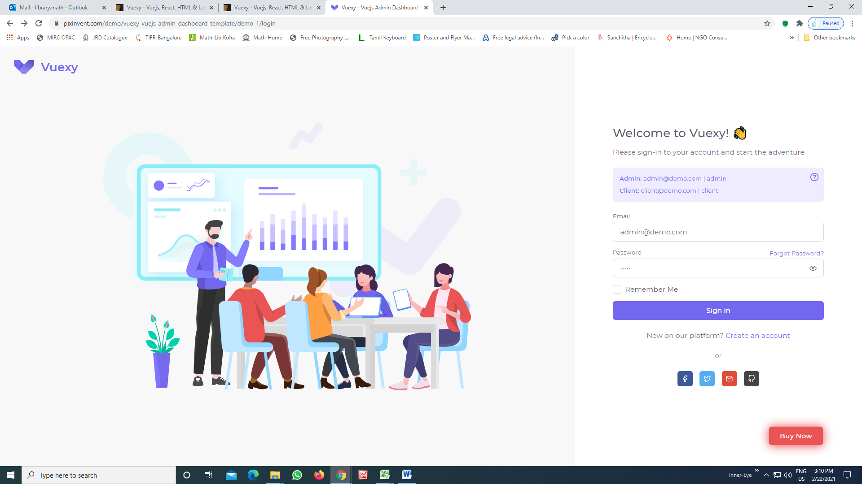
Required: This Login Graphics for Admin

Slide 2
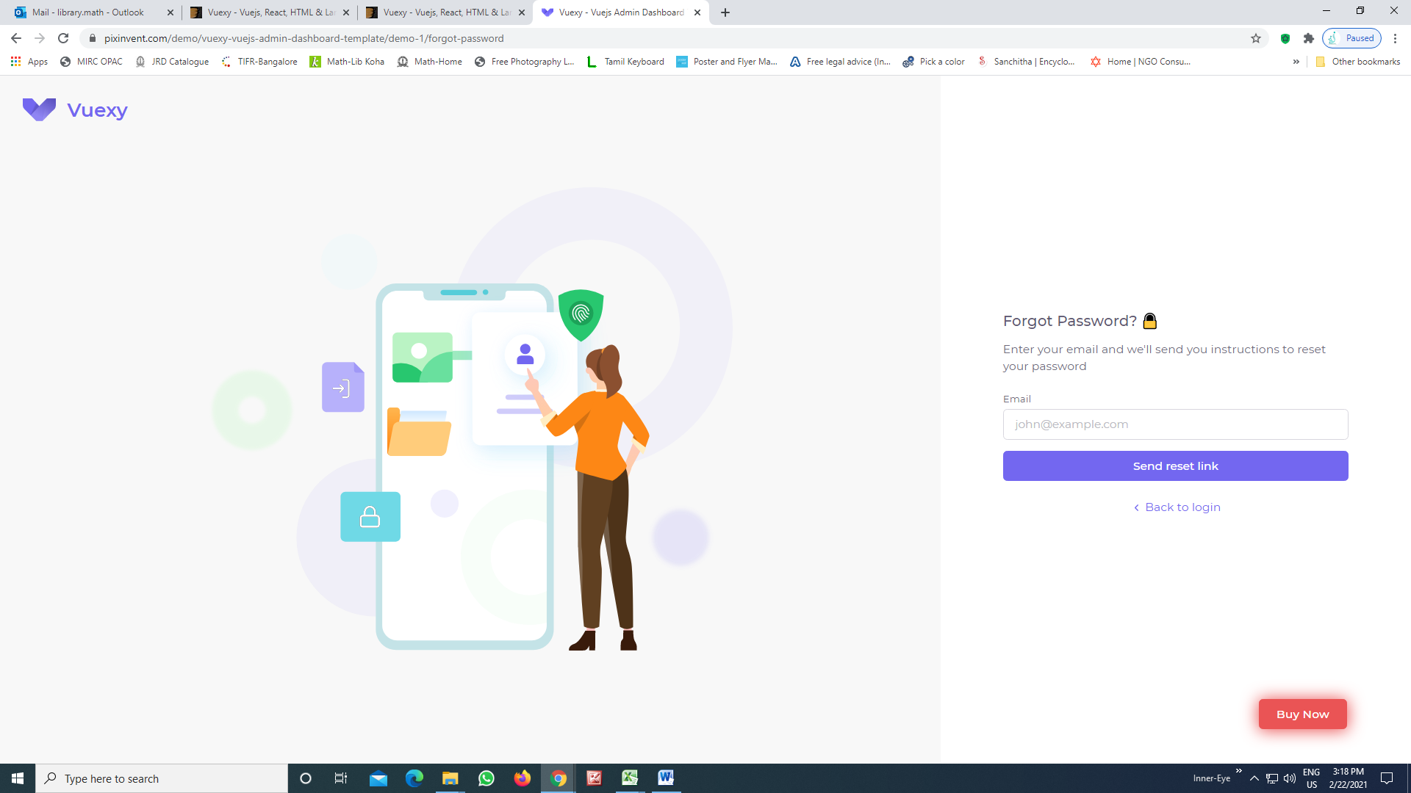
Login for forget password

Slide 3
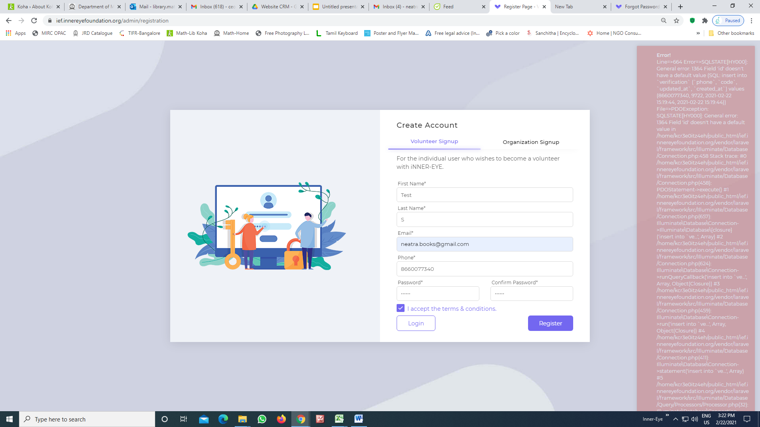
Volunteer & Organisation unable to Register

Slide 4
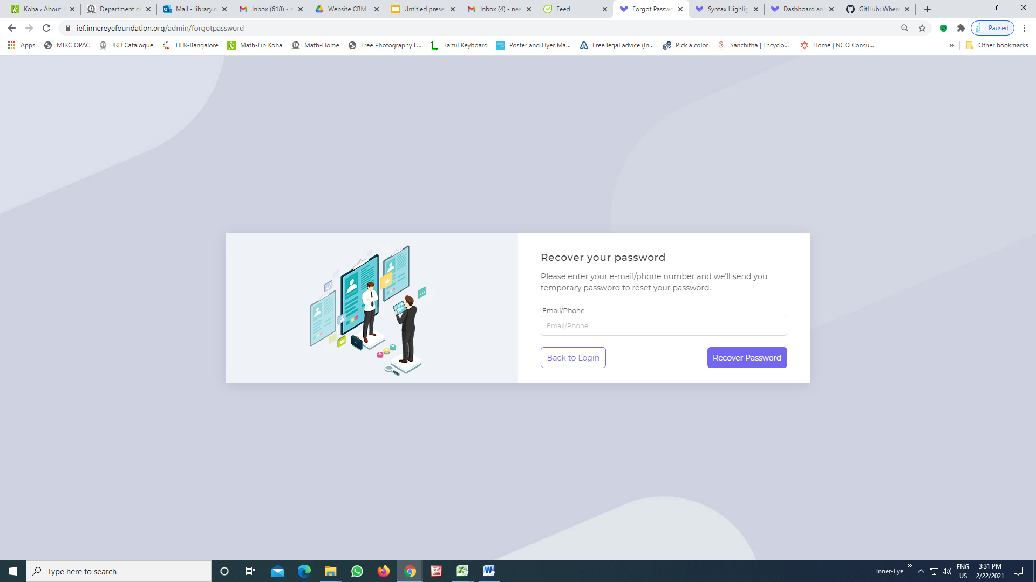
Volunteer unable to recover
Password
OTP Configure (Integration done already, we need to update the SMS sender ID “INNERI”)

Slide 5
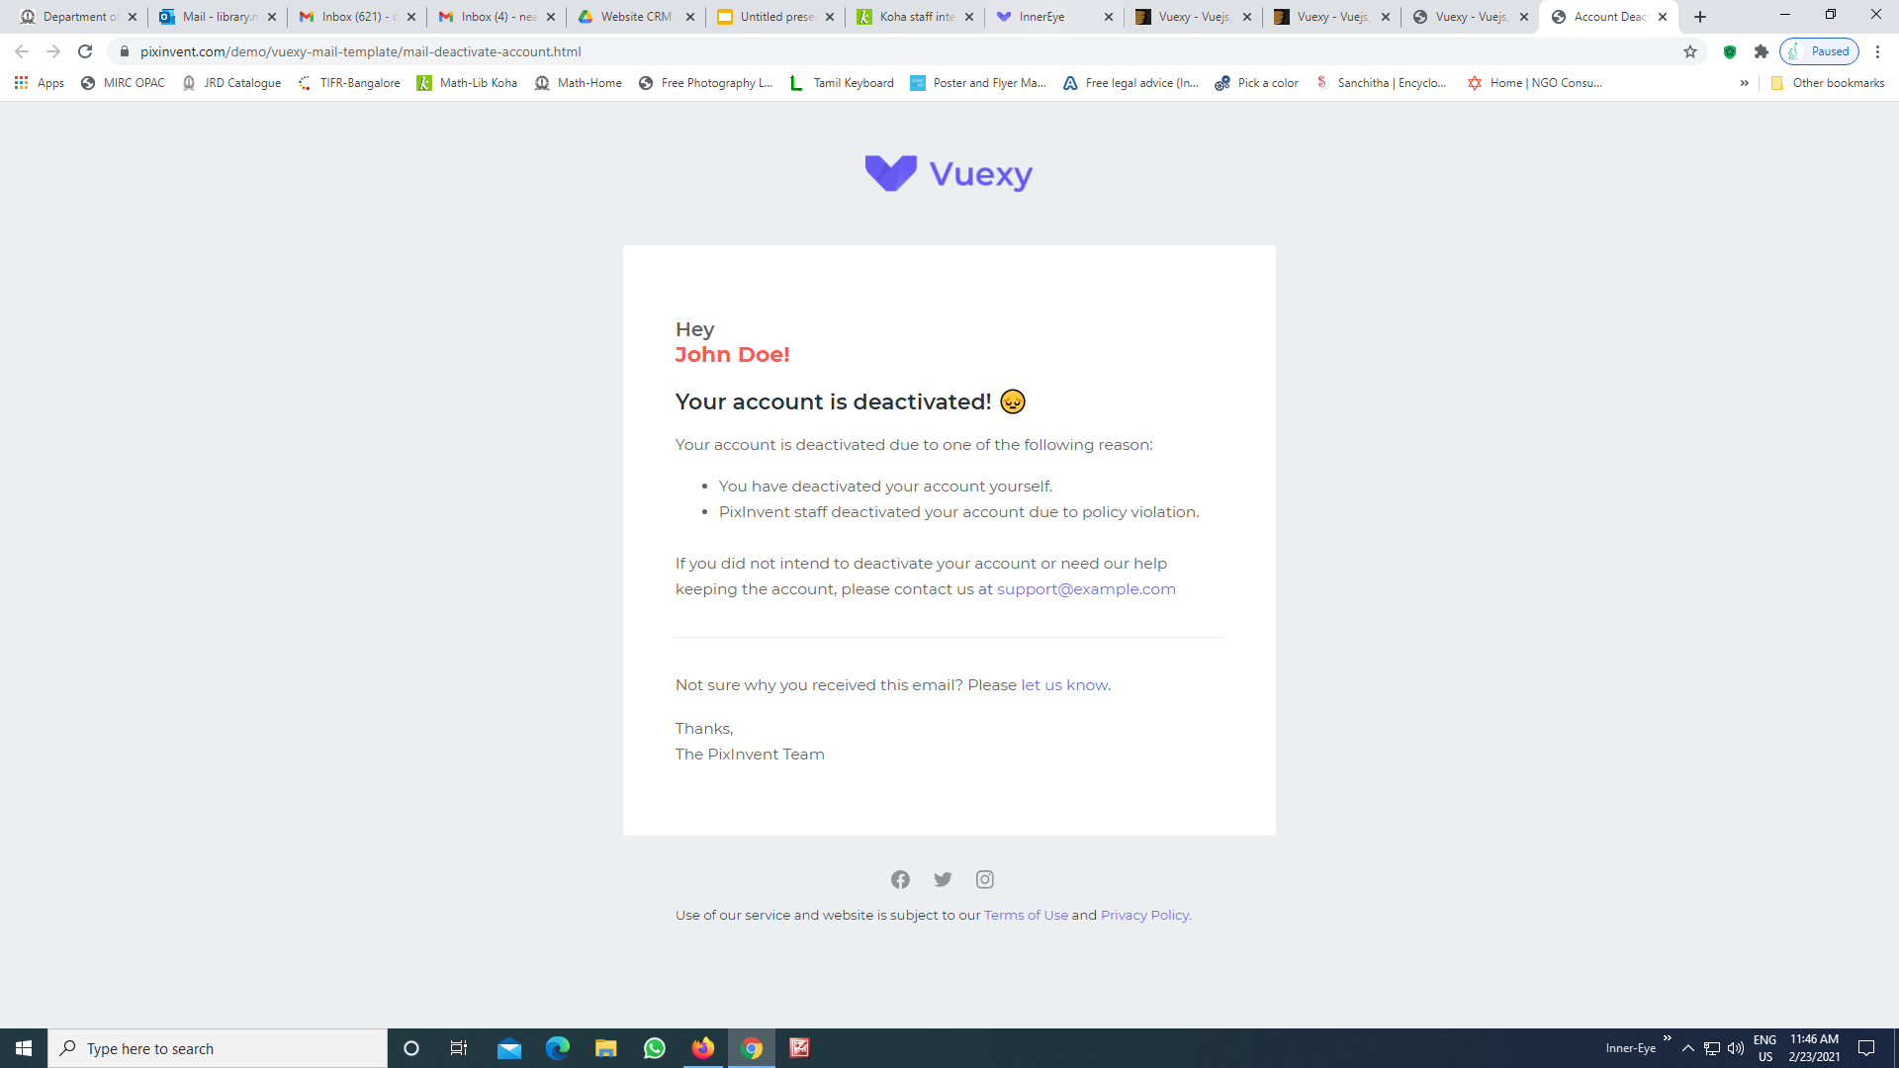
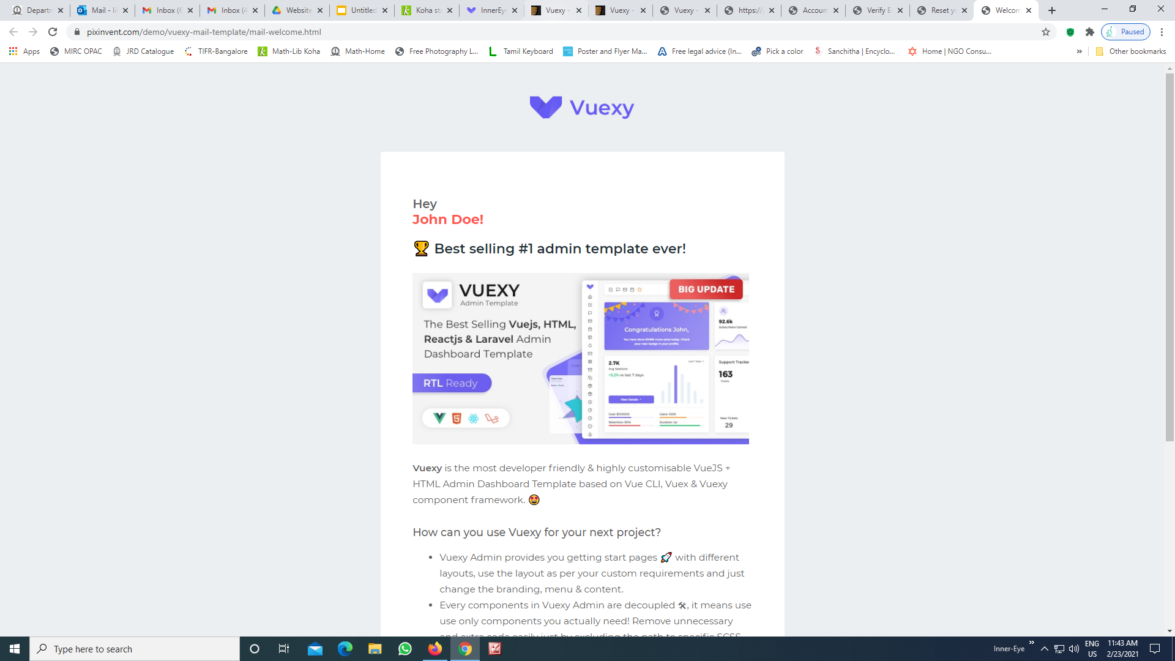
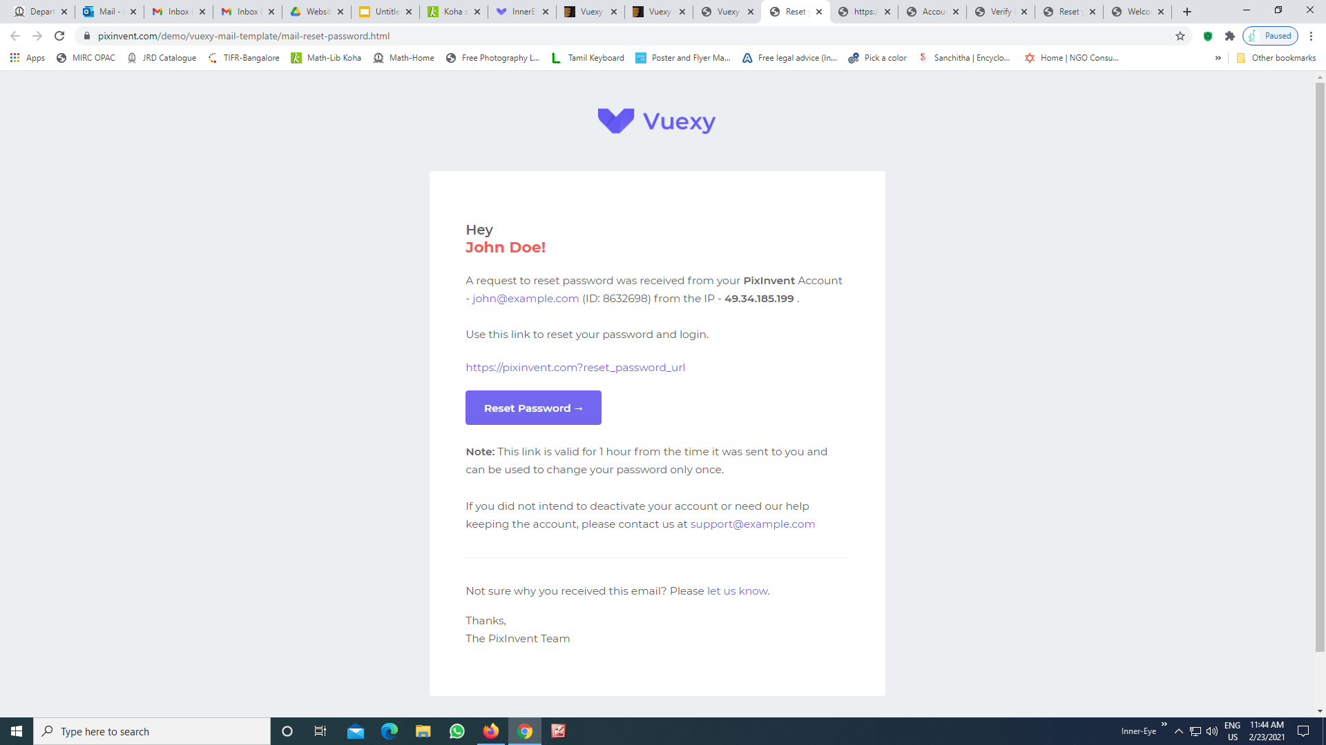
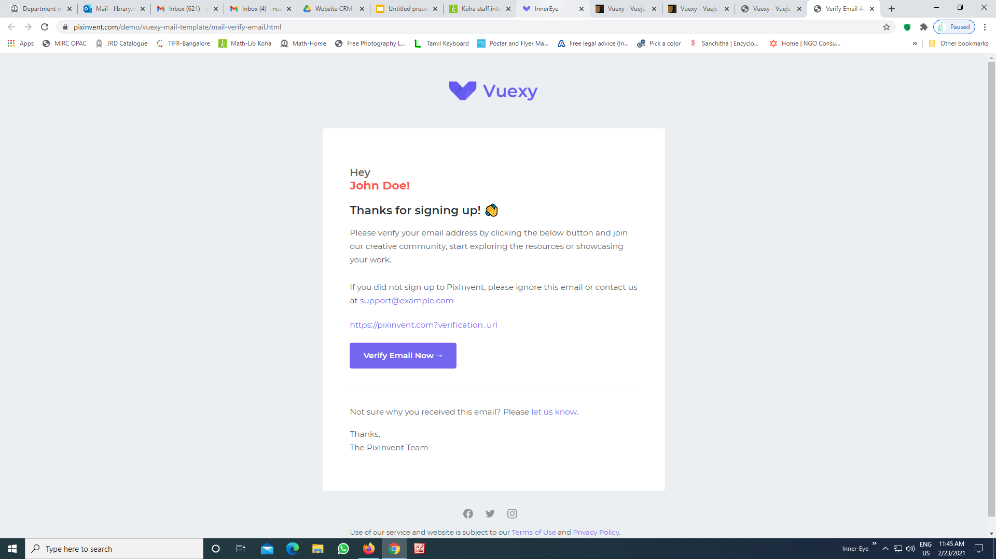
Email Templates: Welcome, Reset Password, Verify Email & Deactivate

Slide 6
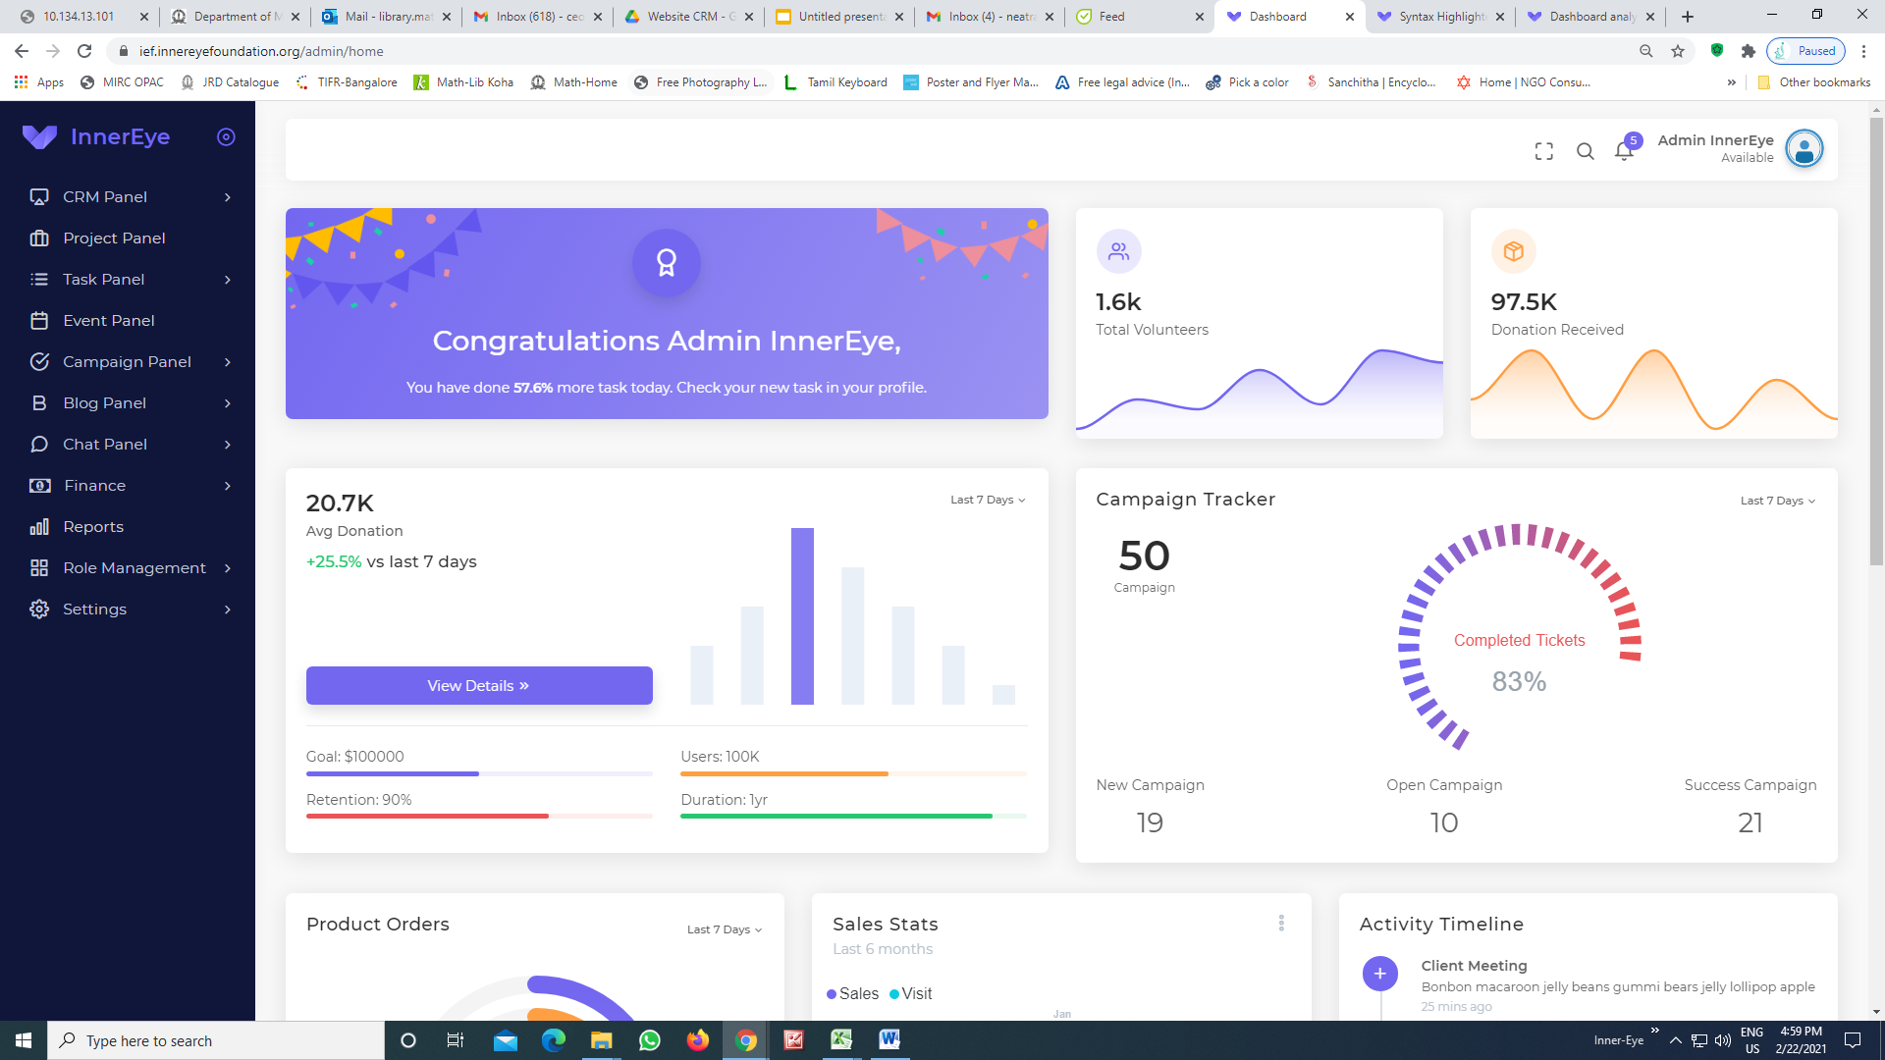
Change to white slider - sidebar

Slide 7
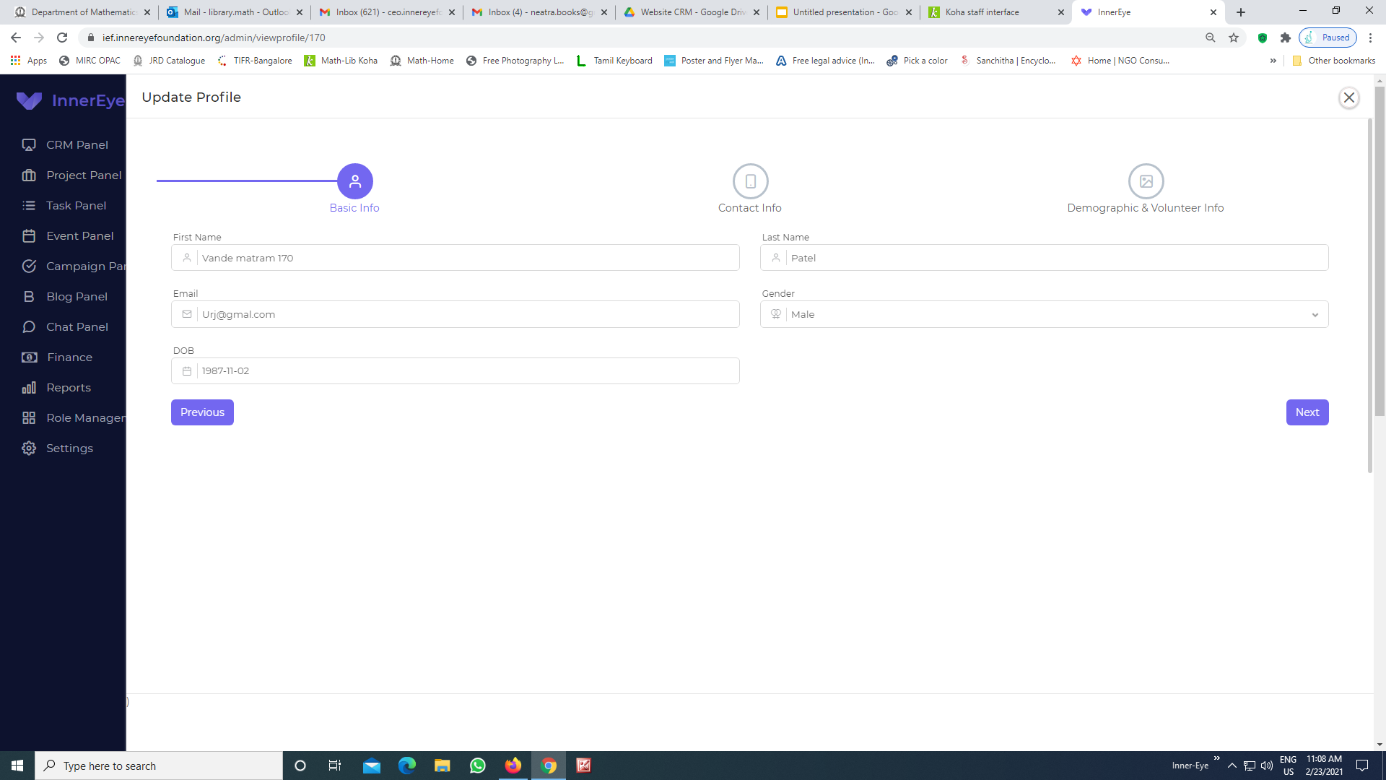
Check the fields: for validity

Slide 8
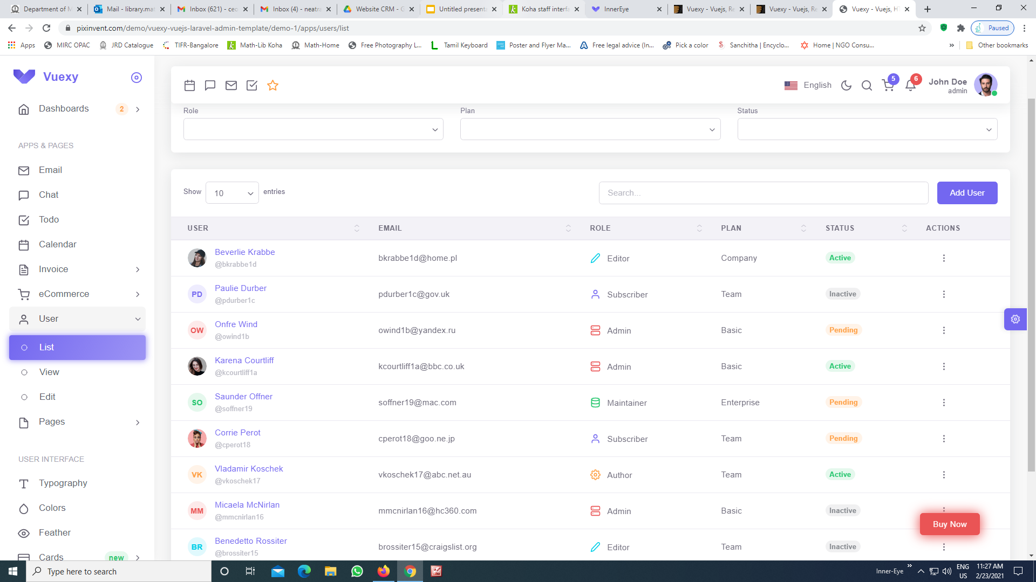
Update the table is required for the tables of volunteer, organisation, beneficiary, project, blog, event and campaign.

Slide 9
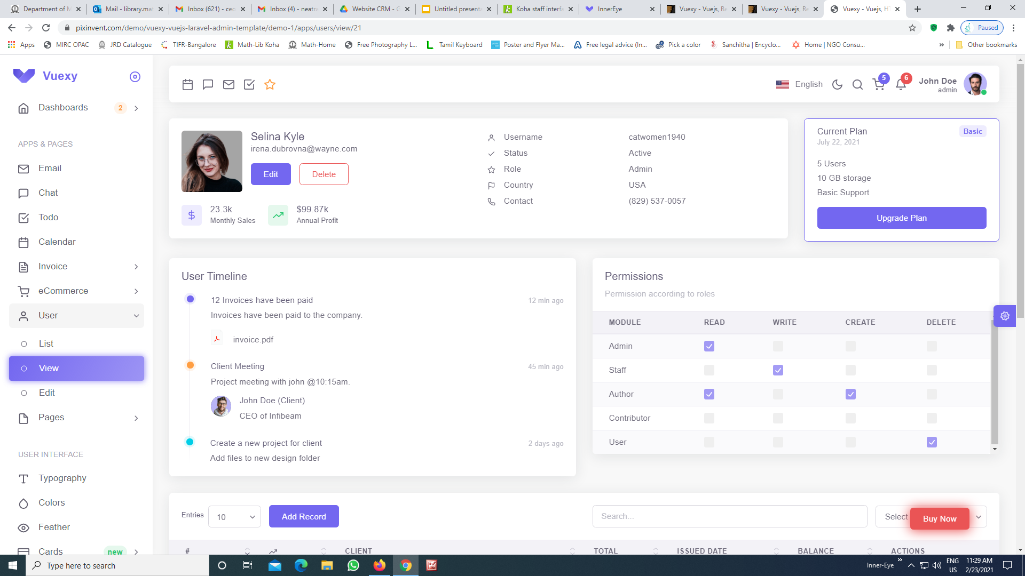
To update the volunteer, organisation, beneficiary profile page

Slide 10
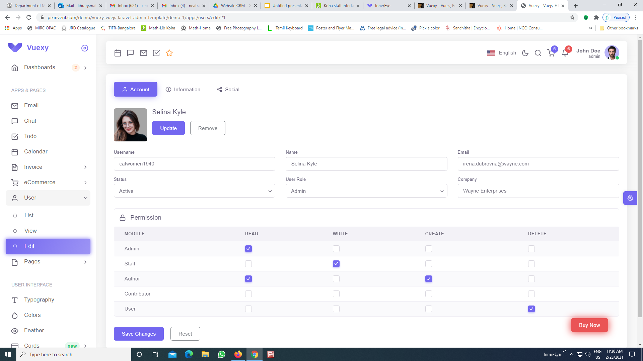
Update volunteer editable form

Slide 11
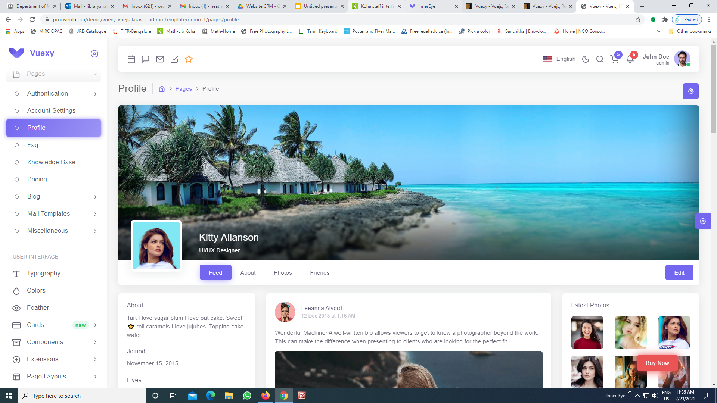
To add Volunteer and organisation Feed page

Slide 12
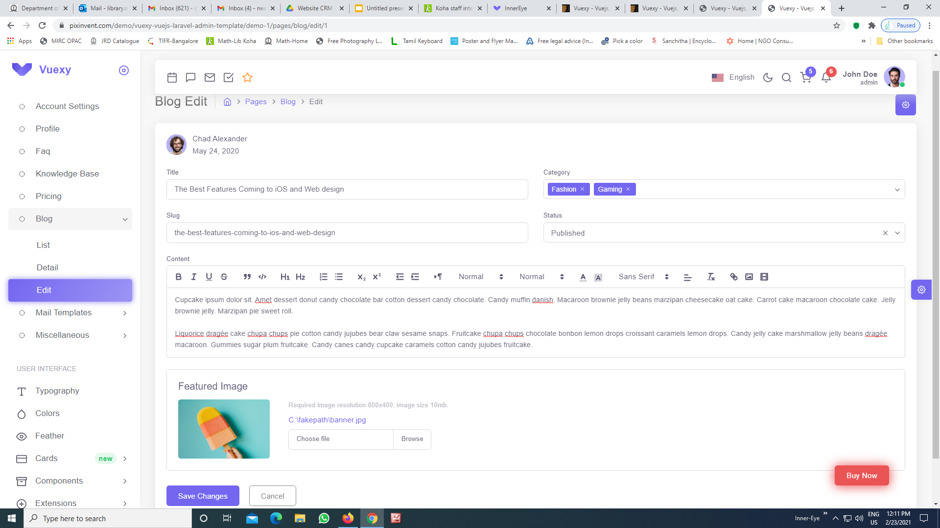
Formating editable form -- project, campaign, blog, event, tasks

Slide 13
Finally finance and report modules have to be designed

